Slide 1
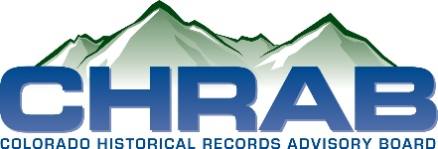
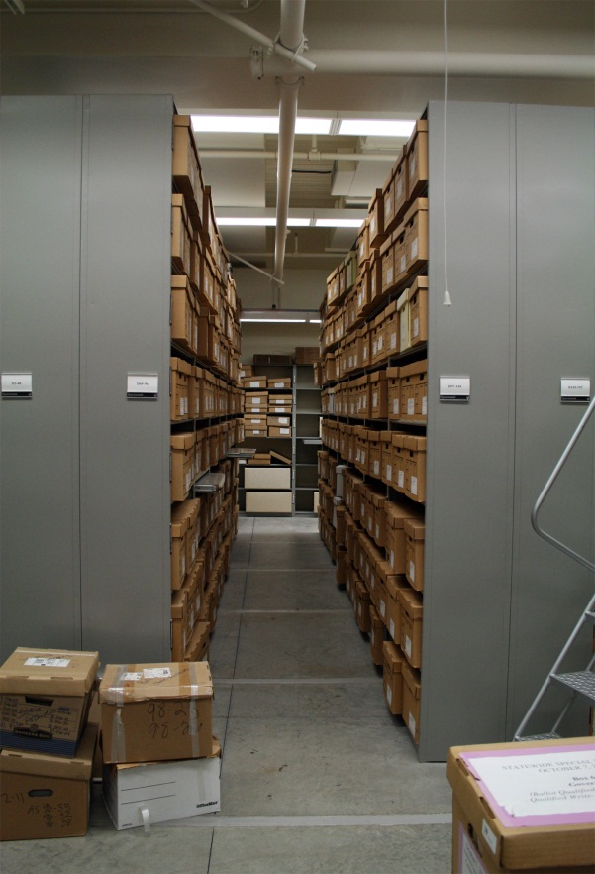
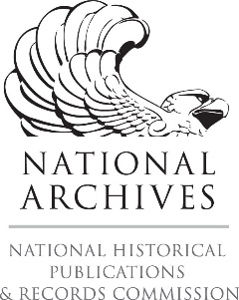
Archives 101
Intro to Archives Management
What do I do with all this stuff?
• Libraries vs Archives vs Museums
• Mission and Vision – Collection Policies
• Appraisal – Not the Antiques Roadshow Kind
• Physical and Intellectual Control
• Respect des Fonds, Provenance and Original Order
• Arrangement
• Description
• Reference and Outreach
• Volunteer Management
• Continuing Education
Shaun Boyd – Archivist, Douglas County Libraries; Aly Jabrocki – Colorado State Archivist Slides also contributed by Jay Trask, George Orlowski and Janet Bishop

Slide 2
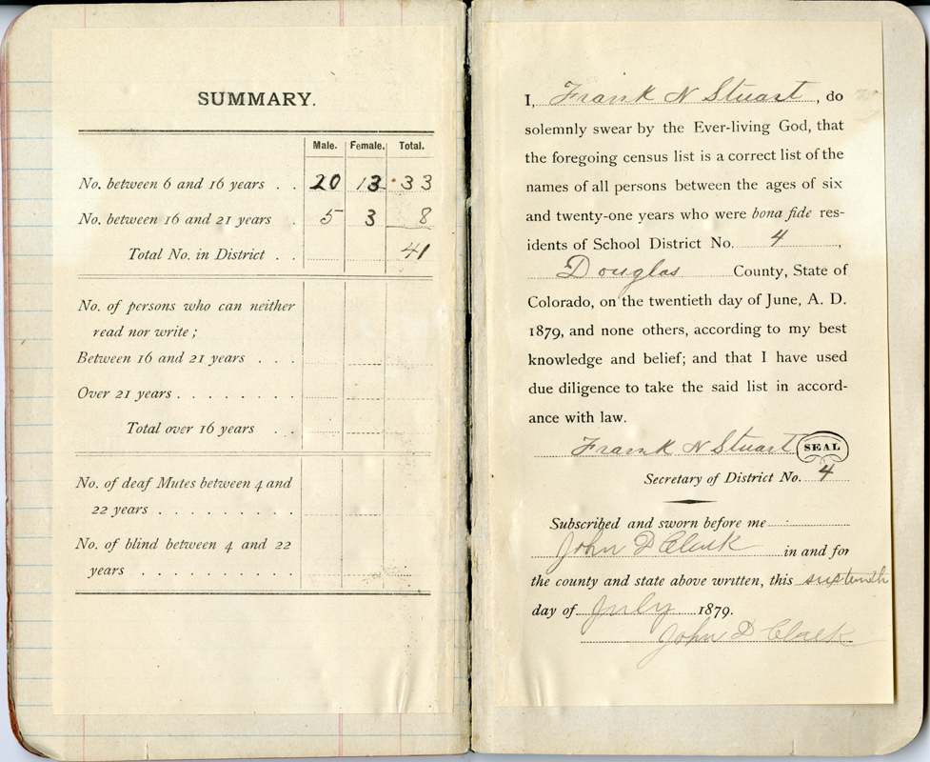
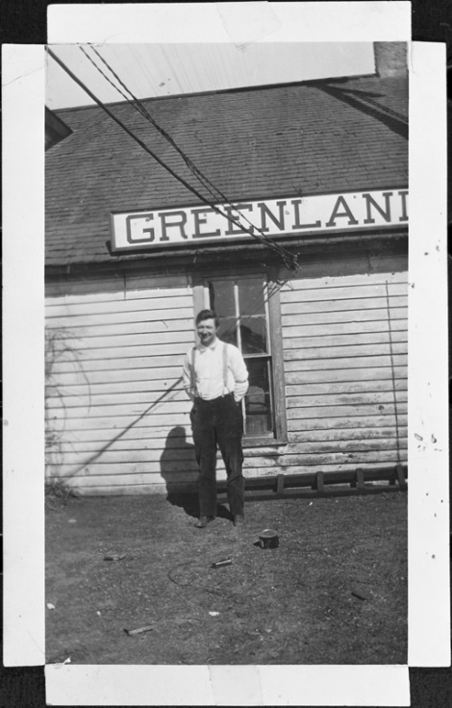
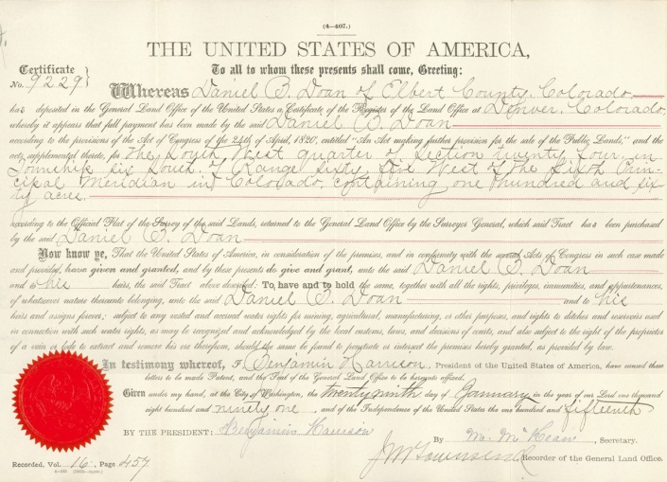
What is an Archive?
Not the place where paper goes to die.
“Archives are the non-current records of an organization or an individual preserved because of their enduring value” –Developing and Maintaining Practical Archives by Greg Hunter
Examples of Material Found in the Archives
Letters (handwritten, typed & email)
Photographs
Minutes/Reports
Diaries
Business records
Speeches/Lectures
Brochures/Flyers/Posters
Film/Video/Audio tapes
Books and Scrapbooks
Ephemera
Newspapers
Microfilm

Slide 3
What does an Archivist do?
Archivists are professionals that take care of historical materials
Archivist. n. ~ 1. An individual responsible for appraising, acquiring, arranging, describing, preserving, and providing access to records of enduring value, according to the principles of provenance, original order, and collective control to protect the materials' authenticity and context. - 2. An individual with responsibility for management and oversight of an archival repository or of records of enduring value. – Society of American Archivists
Examples of Activities Archivists Do
Identify and acquire materials of institutional, cultural, topical or social importance and enduring value
Arrange, describe and preserve collected materials
Make collections available and accessible
Provide reference service
Conduct outreach and education about holdings or collecting areas
Sustain collections through budgeting, fundraising and grant writing
Collaborate with other institutions on special projects
Archivists often have a working knowledge of basic copyright guidelines, digitization standards, preservation standards and facilities maintenance. Donor outreach and cultivation is also a part of the archival enterprise.

Slide 4
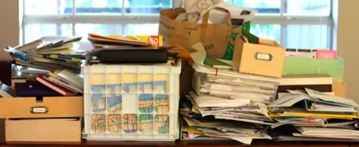
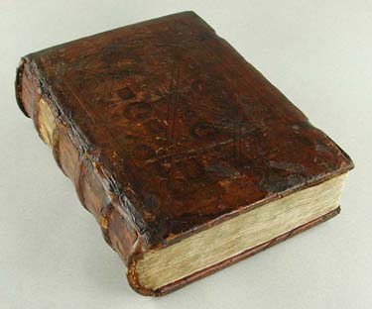
Archives
Principles and Terminology
• Libraries vs Archives vs Museums
• Mission and Vision – Collection Policies
• Appraisal – Not the Antiques Roadshow Kind
• Physical and Intellectual Control
• Respect des Fonds, Provenance and Original Order
• Arrangement and Description
• Preservation
• Reference and Outreach
• Volunteer Management
• Continuing Education
Archives are Messy
Libraries, archives and museums have a lot in common, but they approach their collections in very different ways. Archives get overwhelmed by volume quickly, and have evolved to usually treat the materials in their care in groups, rather than as individual objects. Archival standards for description are much newer than those for libraries, so they are still evolving and only recently established.

Slide 5
Libraries vs Archives vs Museums
Libraries
Archives
Museums
Secondary Sources
Cataloging at the item level
Weeding decisions can be reversed
Items are described and classified according to pre-existing national/ international classification schemes and the judgment of catalogers and metadata specialists
Description standards are well established
Acquisition dependent on budget to build print collections
Primary Sources
Cataloging/Description in aggregate
Weeding decisions are typically irreversible
Materials are arranged and described according to provenance, hierarchy, material type, original order and the judgement of the processing archivists and metadata specialists.
Description standards are for Finding Aids are fairly new.
Acquisition dependent on donor base, or institutional transfers.
Artifacts or material culture objects.
Cataloging at the item level
Weeding decisions are typically irreversible
Items are described according to institutional-specific standards, and can vary greatly from one type of institution to another.
Description standards are fairly new (Nomenclature, Getty)
Acquisition dependent on donor base or purchase.

Slide 6
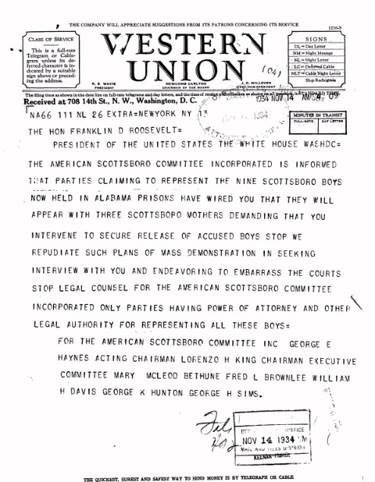
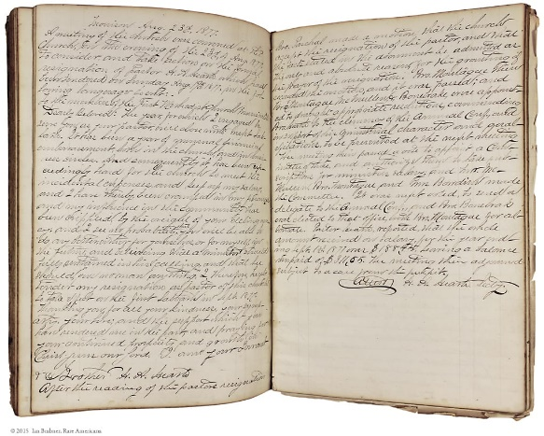
Terminology – Records vs Manuscripts
Records*
Manuscripts*
Traditionally typed, reproduced or otherwise created in a business environment
Materials created by an institution, corporation, organization or government agency (e.g., University of Northern Colorado, Boeing, USDA, Rocky Mountain Farmers Union)
Traditional title of oversight position: “Archivist”
Traditionally housed in Archives
Collections reflect the needs and operations of the creating organization. Part of preserving the “Institutional Memory” of the organization
Traditionally handwritten, unique materials such as letters, original writings or photographs
The papers and collateral materials of an individual or family (e.g., James Joyce, James Madison)
Traditional title of oversight position: “Manuscript Curator”
Traditionally housed in Repositories or Special Collections Departments
Collections reflect the collection policies, topical area interests, or research interests of the repository.
*The lines of these traditional distinctions are now often blurred. For example University archival departments often contain university records, records of other organizations and manuscript collections/papers of individuals, or a Public Library special collections department may collect the library’s history as well.

Slide 7
Archives
Principles and Terminology
• Libraries vs Archives vs Museums
• Mission and Vision – Collection Policies
• Appraisal – Not the Antiques Roadshow Kind
• Physical and Intellectual Control
• Respect des Fonds, Provenance and Original Order
• Arrangement and Description
• Preservation
• Reference and Outreach
• Volunteer Management
• Continuing Education
Mission and Vision
Know what you do. Without a clear mission, your archives will quickly be overwhelmed. Without a collection policy, you could end up as the attic for your community. You should establish policies for what you discard too. (called deaccessioning)

Slide 8
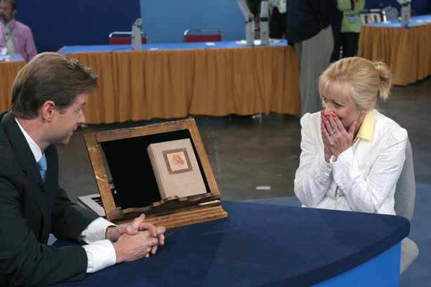
Archives
Principles and Terminology
• Libraries vs Archives vs Museums
• Mission and Vision – Collection Policies
• Appraisal – Not the Antiques Roadshow Kind
• Physical and Intellectual Control
• Respect des Fonds, Provenance and Original Order
• Arrangement and Description
• Preservation
• Reference and Outreach
• Volunteer Management
• Continuing Education
Appraisal - Does it Fit?
Unlike Antiques Roadshow, Archivists are not supposed to primarily think of the monetary value of items in their care. Archives assess and acquire material that fits in with their collections, answers a question, fills a need or applies to their subject. Having a collection policy to guide you is critical, because sometimes, no matter how awesome to object or collection, you have to say no.

Slide 9
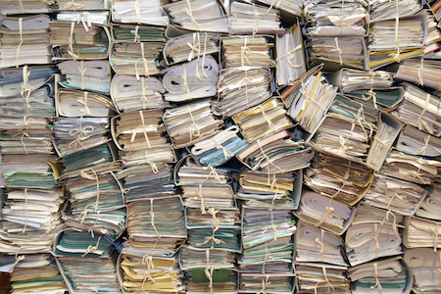
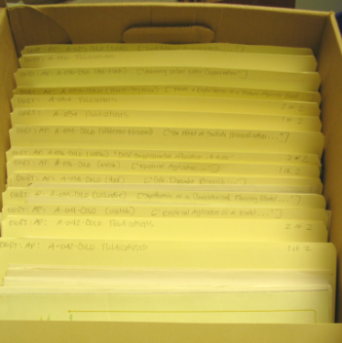
Things to consider for Appraisal
Primary considerations
Does this collection fit with my institution’s mission and collecting policy?
Does this collection complement or complete/add to the collections we already have?
Are we the best repository for these materials? Will people look for them here?
Is this the best version available?
Secondary considerations
Do we have the space to house these materials?
Do we have the person-power to do base-level organization and processing of these materials?
Can we get a grant to process these materials or is there funding attached to the donation? What stipulations are attached to donation funding?
Consider who holds the copyright to materials deeded to your institution

Slide 10
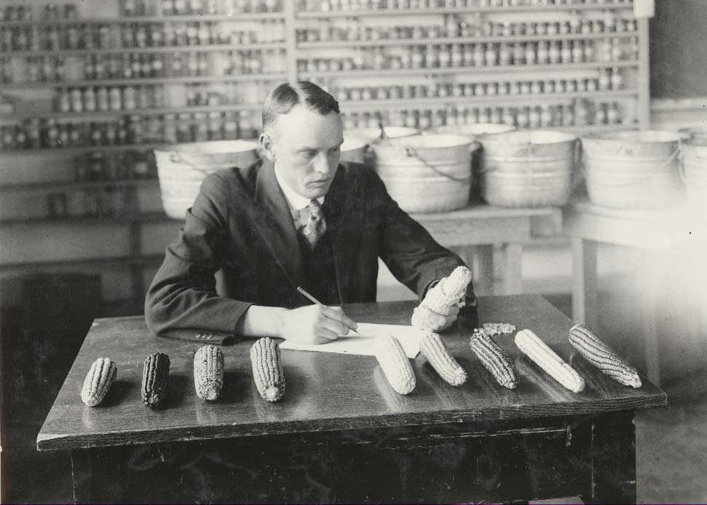
Terminology – Value
Informational Value: Is the material important? Does it have researcher value? Is it a unique way to document something? Materials that document people, places, things, events. (e.g., student newspapers, Sanborn maps)
Evidential Value: Is this the best evidence? Most complete? Evidential value has to do with the creator of the materials in some way, documenting the decision making process or other activities.
Intrinsic Value: Materials linked with fame, important event, artistic merit, uniqueness of format, high monetary value (e.g., Declaration of Independence, glass plate negatives)
An object could contain all three of these values, or it could only have one, or any combination of the three.
Image: University Historic Photograph Collection, Colorado State University, Archives and Special Collections, http://lib.colostate.edu/archives/uhpc/

Slide 11
Terminology – Retention
Retention is the idea within (particularly institutional) archives about how long to keep something. Retention is generally not tied to the physical or digital nature of the materials.
Permanent Retention: Materials that should be permanently kept by the archives.
Minutes, proceedings, reports by administrative committees or departments
Newspapers, newsletters or other unique, rich sources of information
Writings or other intellectual output
Photographs, slides, dvds and other av files
Legal and administrative documents such as deeds, mortgages, etc.
Scrapbooks and other items that document activities.
Maps, charts, diagrams or blueprints
Temporary Retention: Materials that are kept for a limited time to meet legal or other requirements.
Bank statements, voided checks
Purchasing records, receipts, sales records, shipping materials
Account books, expense statements
Routine form letters and correspondence
Statistics for office or other reports
No Retention: Materials that are not kept beyond their immediate use.
Duplicates
Notes, memos, etc., of a temporary nature.
Working files of published materials
Preliminary drafts unless they show significant changes
Extra stacks of publications
Routing slips
Important tip to remember: Take into account your “born digital materials” and where they reside. The Intrinsic or Informational Value of an item may make it worth keeping. (Linked with fame or a famous individual, an important event, artistic merit, uniqueness of format, high monetary value.)

Slide 12
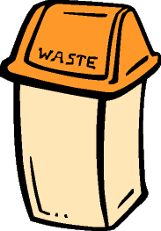
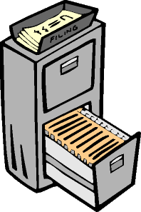
Life Cycle of Records
Creation
Distribution and Use
?
Final Disposition
Archive, Transfer, Migrate, Reformat, or Destroy?
Classification and Filing
Storage
On site or remote?

Slide 13
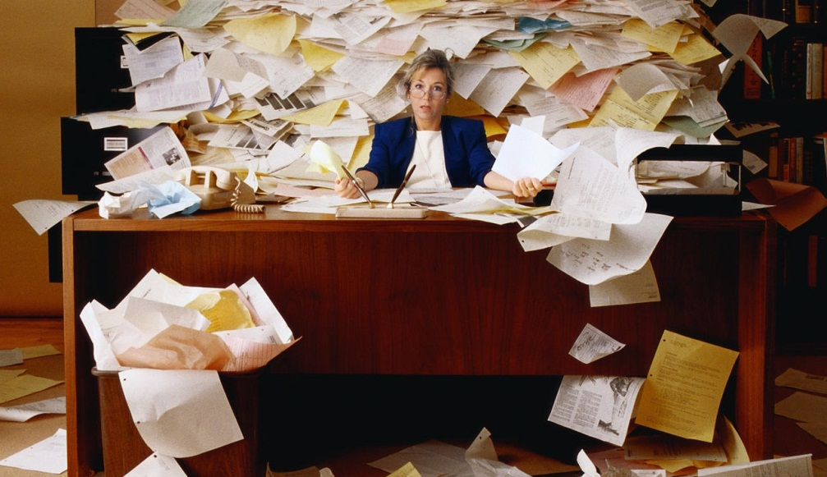
Archives
Principles and Terminology
• Libraries vs Archives vs Museums
• Mission and Vision – Collection Policies
• Appraisal – Not the Antiques Roadshow Kind
• Physical and Intellectual Control
• Respect des Fonds, Provenance and Original Order
• Arrangement and Description
• Preservation
• Reference and Outreach
• Volunteer Management
• Continuing Education
Accessioning Process
Bringing materials into the collection requires not only appraisal, but legal transfer of the materials. A deed of donation is important to acknowledge the chain of ownership. The idea of intellectual control speaks to understanding how the materials are organized.

Slide 14
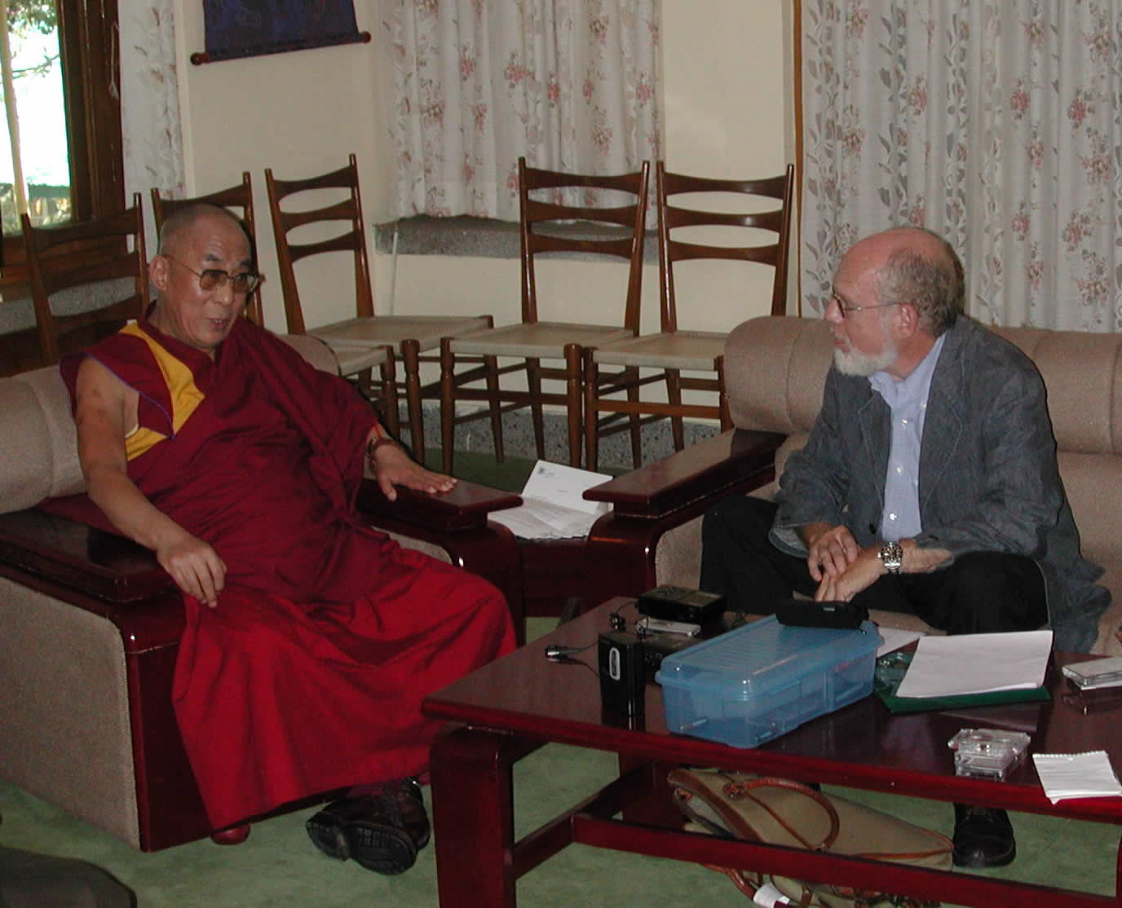
Important forms for Accessioning
Deed of Gift or Deed of Donation
Transfers materials from one person or entity to your institution in a legal way
Helps with tracking who gave what and when
Deed of Donation or Consent or Release for an Oral History interview
Signed by interviewee and interviewer to show that they consent to make the interview available
Important to mention or take into account putting interviews online or in some other form in the future
Internal transfer form
Institutional repositories and archives still need to document when and where a set of records entered the collection
Professor Goldstein conducting an oral history interview with H.H. the Dalai Lama, in Dharamsala, India, 2004. Photo courtesy Case Western Reserve University.

Slide 15
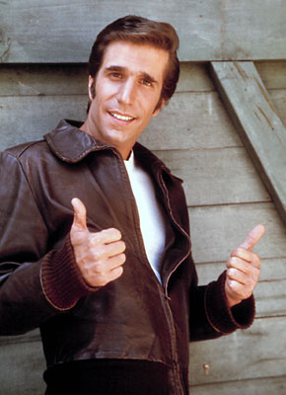
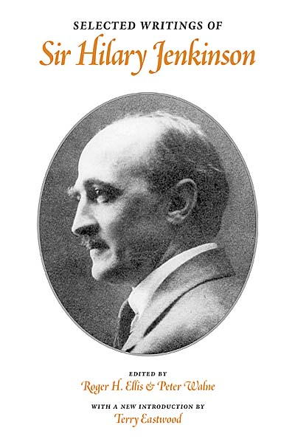
Archives
Principles and Terminology
• Libraries vs Archives vs Museums
• Mission and Vision – Collection Policies
• Appraisal – Not the Antiques Roadshow Kind
• Physical and Intellectual Control
• Respect des Fonds, Provenance and Original Order
• Arrangement and Description
• Preservation
• Reference and Outreach
• Volunteer Management
• Continuing Education
Archival Philosophy
Sir Hilary Jenkinson, Archives own Monuments Man, laid out the philosophy of archival collections, building on French archivists’ concepts of Respect des Fonds, Provenance and Original Order.

Slide 16
Archival Philosophy
What we learned from the French and Prussians…
Provenance
The materials generated by one individual, organization or department should not be mixed or combined with the materials of another.
Original order*
Materials should be kept and arranged in the order in which they were originally created, maintained or used.
*Preserving original order is not the same as preserving original chaos.

Slide 17
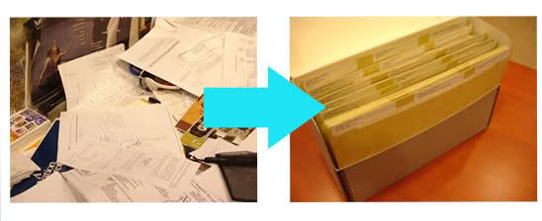
Archives
Principles and Terminology
• Libraries vs Archives vs Museums
• Mission and Vision – Collection Policies
• Appraisal – Not the Antiques Roadshow Kind
• Physical and Intellectual Control
• Respect des Fonds, Provenance and Original Order
• Arrangement and Description
• Preservation
• Reference and Outreach
• Volunteer Management
• Continuing Education
Arrangement
Preserving original order does not mean preserving original disorder. Look at the materials and see if any major categories (called Series) emerge. Then look for sub-series. If possible, retain the folder labels and work them into your new series and sub-series schema. When everything is arranged, label the folders and create a box and folder or container list. Very few archives use item level records, and then only for the most important documents.

Slide 18
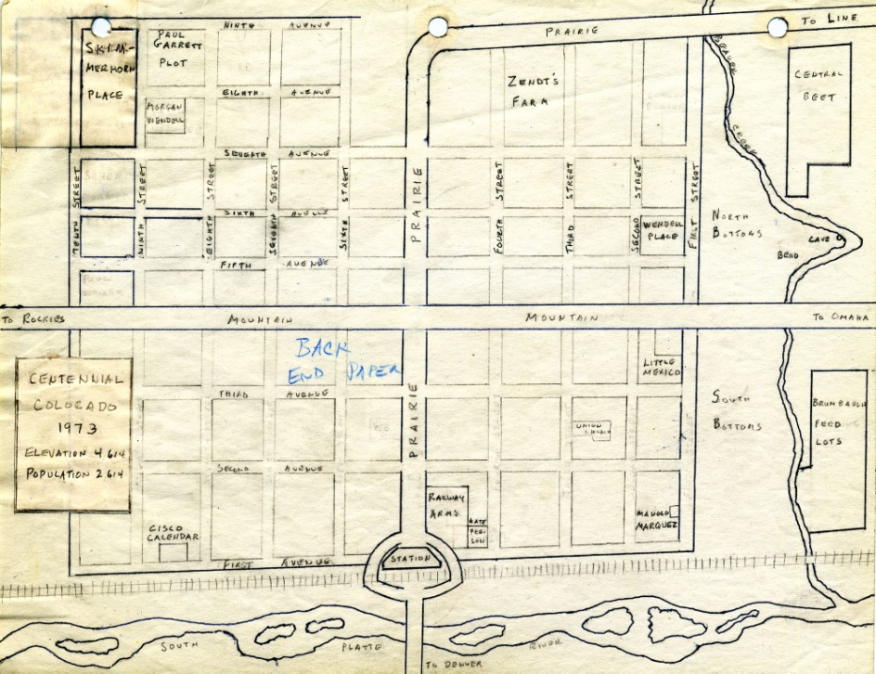
Arrangement and Description
Levels of Arrangement
Repository
Record Group (collection)
Series
File Unit
Item
Types of Arrangement
Alphabetical
Chronological
Geographical
Subject
Numerical

Slide 19
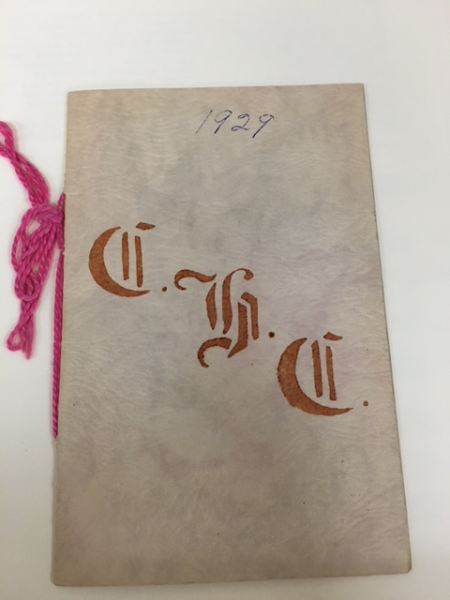
Arrangement and Description
Levels of Arrangement - Example
Repository: Douglas County History Research Center
Collection: Cherry Homemaker’s Club Records
Series: Programs
File Unit: Folder 24 (1925-1930)
Item: The 1929 Program Book

Slide 20
Arrangement and Description
Physical Arrangement
Weeding
Rehousing
Labelling
Basic preservation

Slide 21
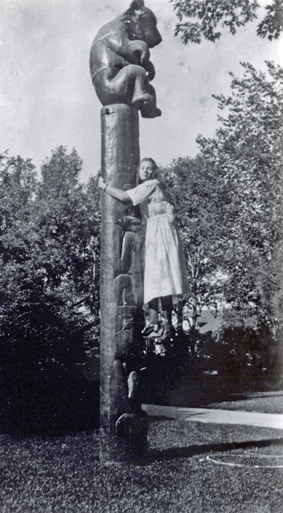
Arrangement and Description
More Product, Less Process
Goals of MPLP processing
Expediting the availability of collections to users.
Assuring adequate arrangement of materials for users needs.
Taking minimum steps necessary for physically preserving collection materials.
Describing materials sufficiently for use.

Slide 22
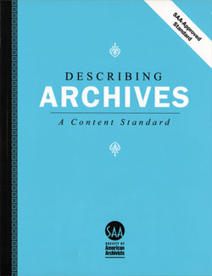
Archives
Principles and Terminology
• Libraries vs Archives vs Museums
• Mission and Vision – Collection Policies
• Appraisal – Not the Antiques Roadshow Kind
• Physical and Intellectual Control
• Respect des Fonds, Provenance and Original Order
• Arrangement and Description
• Preservation
• Reference and Outreach
• Volunteer Management
• Continuing Education
Description
Having the materials arranged is all well and good, but without description no one can find it! Some archives use written guides to their collections (even typed ones!) called Finding Aids, while others use integrated databases like Archives Space, ContentDM or Past Perfect. Several standards have emerged, including DACS, ISAD and EAD. Of course library standards like MARC and a new standard called RDA are also used by archives and libraries.

Slide 23
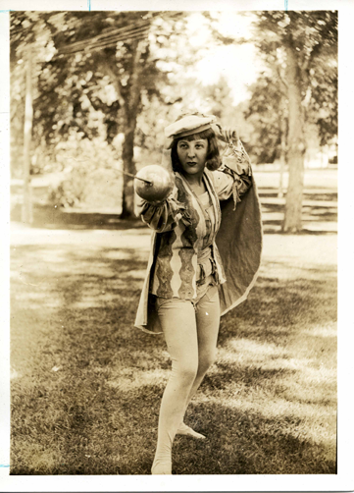
Arrangement and Description
Finding Aid Descriptive Fields
Administrative/Biographical history
Description of the records
Scope and content
Series descriptions
Container/folder list
Administrative information
Content Standards
DACS
AACR2
Locally created

Slide 24
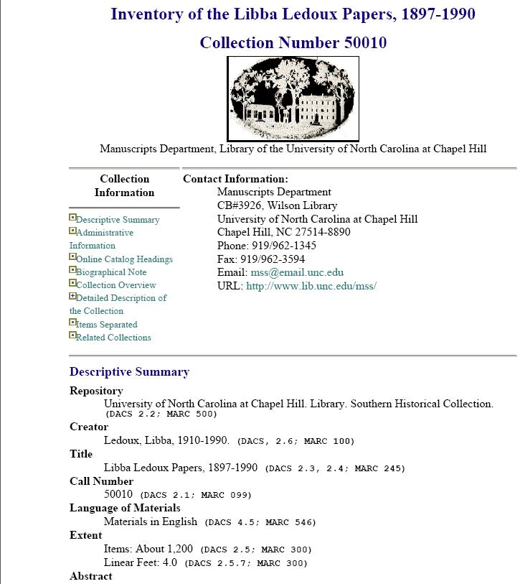
Arrangement and Description
Finding Aid Delivery Methods
Paper-based
PDF/Electronic documents
EAD
MARC
Archival Content Management Systems
ArchivesSpace
Eloquent
CollectiveAccess
Past Perfect
ContentDM

Slide 25
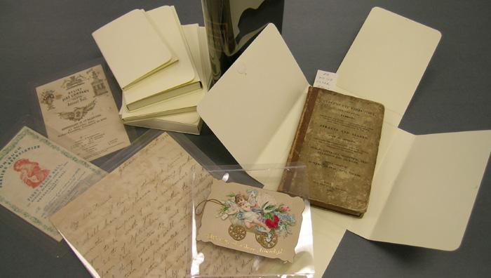
Archives
Principles and Terminology
• Libraries vs Archives vs Museums
• Mission and Vision – Collection Policies
• Appraisal – Not the Antiques Roadshow Kind
• Physical and Intellectual Control
• Respect des Fonds, Provenance and Original Order
• Arrangement and Description
• Preservation
• Reference and Outreach
• Volunteer Management
• Continuing Education
Preservation
Parallel to the arrangement and description process is often preservation of the materials in the archives care for long term storage. Monitoring environmental conditions, preparing for and mitigating biological and physical threats, and even disaster planning are all part of the preservation process.

Slide 26
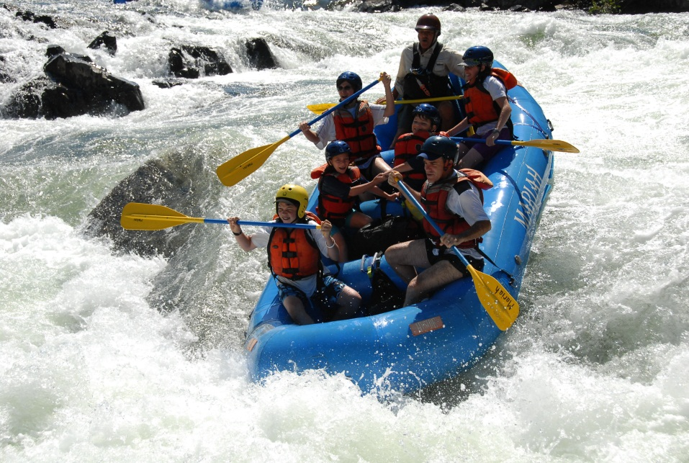
Archives
Principles and Terminology
• Libraries vs Archives vs Museums
• Mission and Vision – Collection Policies
• Appraisal – Not the Antiques Roadshow Kind
• Physical and Intellectual Control
• Respect des Fonds, Provenance and Original Order
• Arrangement and Description
• Preservation
• Reference and Outreach
• Volunteer Management
• Continuing Education
Reference, Access and Outreach
Librarians and Archivists used to be gatekeepers of information. With an increased amount of material online, that role has diminished. Now users are flooded with information, and a good librarian or archivist spends a lot of their time navigating the information flood to get you to what you want. Librarians (and most archivists are trained as librarians) spend time in school learning about how to ask the right questions to navigate your request.

Slide 27
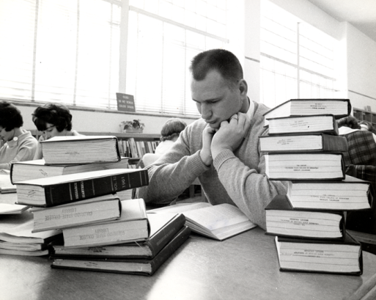
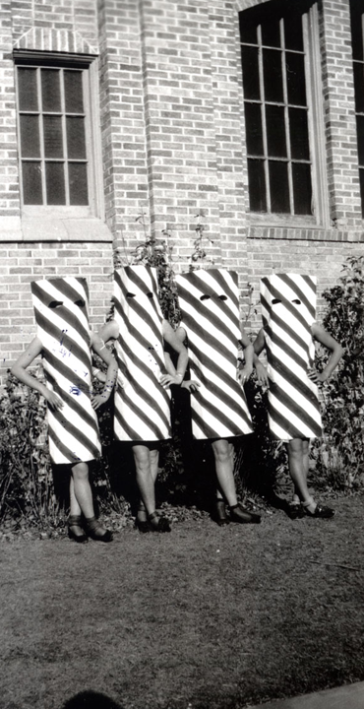
Archival Reference
Providing information about holdings
Assisting with research visits
Research interview
Reference room activities
Duplication services
Copyright concerns
Negotiating access restrictions
Copyright
Donor restrictions
Preservation concerns

Slide 28
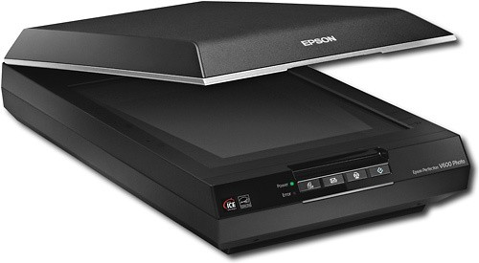
Digitization
Digitization planning process
Access
Priorities
Preservation
Equipment
Metadata creation
Standards
File Formats
Scanning Specs

Slide 29
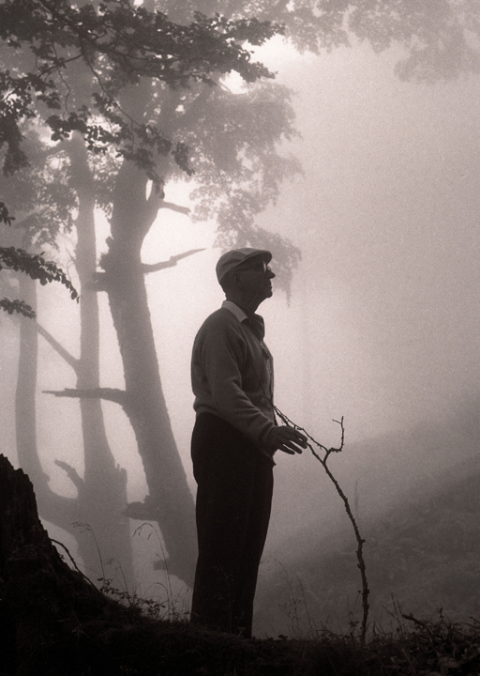
Grants
NHPRC
NEH
IMLS
CHRAB
CIPA

Slide 30
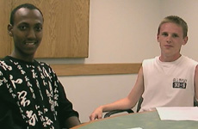
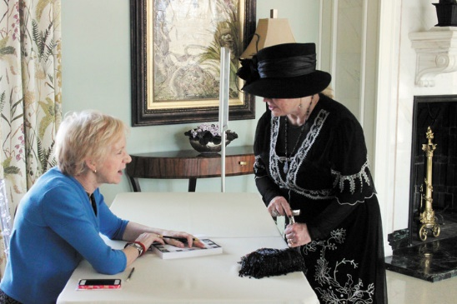
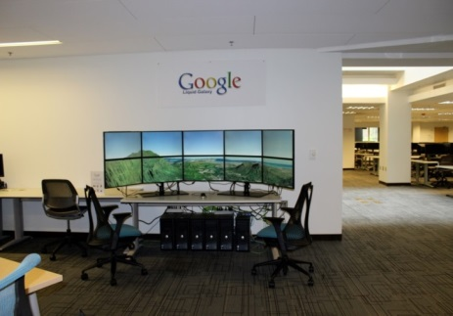
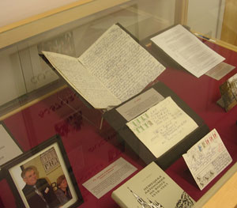
Outreach and Publicity
Promotional Materials
Brochures and Pamphlets
Postcards
Press Releases
Cards and Calendars with Historic Images
Giveaways
Articles in the local paper
Web and Social Media
Youtube
Blogs
Facebook, etc.
Wikipedia
Crowdsourcing possibilities
Fundraisers and other Community Events
Water Tables
Ladies of Downton Abbey
CSU’s “RamStories” Oral History Project
Author Carol Wallace, left, signs a copy of her book, "To Marry an English Lord: Tales of Wealth and Marriage, Sex and Snobbery," for Littleton resident, Maryalyce Allery, at the Dames of Downton event put on by the Douglas County Libraries at the Highlands Ranch Mansion Jan. 25
Google Liquid Galaxy Display @ CSU
Website for CSU’s Water Resources Archive: http://lib.colostate.edu/archives/water/

Slide 31
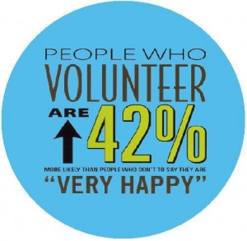
Archives
Principles and Terminology
• Libraries vs Archives vs Museums
• Mission and Vision – Collection Policies
• Appraisal – Not the Antiques Roadshow Kind
• Physical and Intellectual Control
• Respect des Fonds, Provenance and Original Order
• Arrangement and Description
• Preservation
• Reference and Outreach
• Volunteer Management
• Continuing Education
Volunteer Management
Many archives depend on volunteers for many tasks including transcribing and conducting oral histories, cleaning photos, preparing materials to go online and general research. Matching volunteers with tasks, keeping them interested in coming to work, and honoring their work are all parts of the day for some archivists. Our hardest task is finding the right job for the right person. They finish our tasks so quickly!

Slide 32
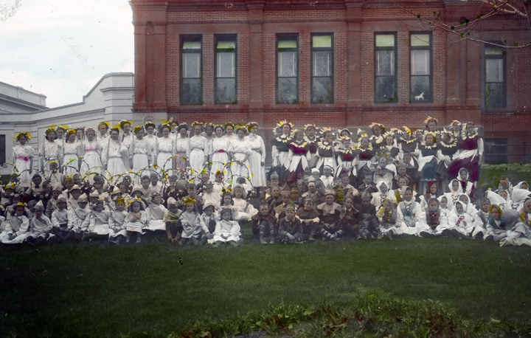
Continuing Education
Archives
Principles and Terminology
• Libraries vs Archives vs Museums
• Mission and Vision – Collection Policies
• Appraisal – Not the Antiques Roadshow Kind
• Physical and Intellectual Control
• Respect des Fonds, Provenance and Original Order
• Arrangement and Description
• Preservation
• Reference and Outreach
• Volunteer Management
• Continuing Education
Many archives depend on volunteers for many tasks including transcribing and conducting oral histories, cleaning photos, preparing materials to go online and general research. Matching volunteers with tasks, keeping them interested in coming to work, and honoring their work are all parts of the day for some archivists. Our hardest task is finding the right job for the right person. They finish our tasks so quickly!

Slide 33
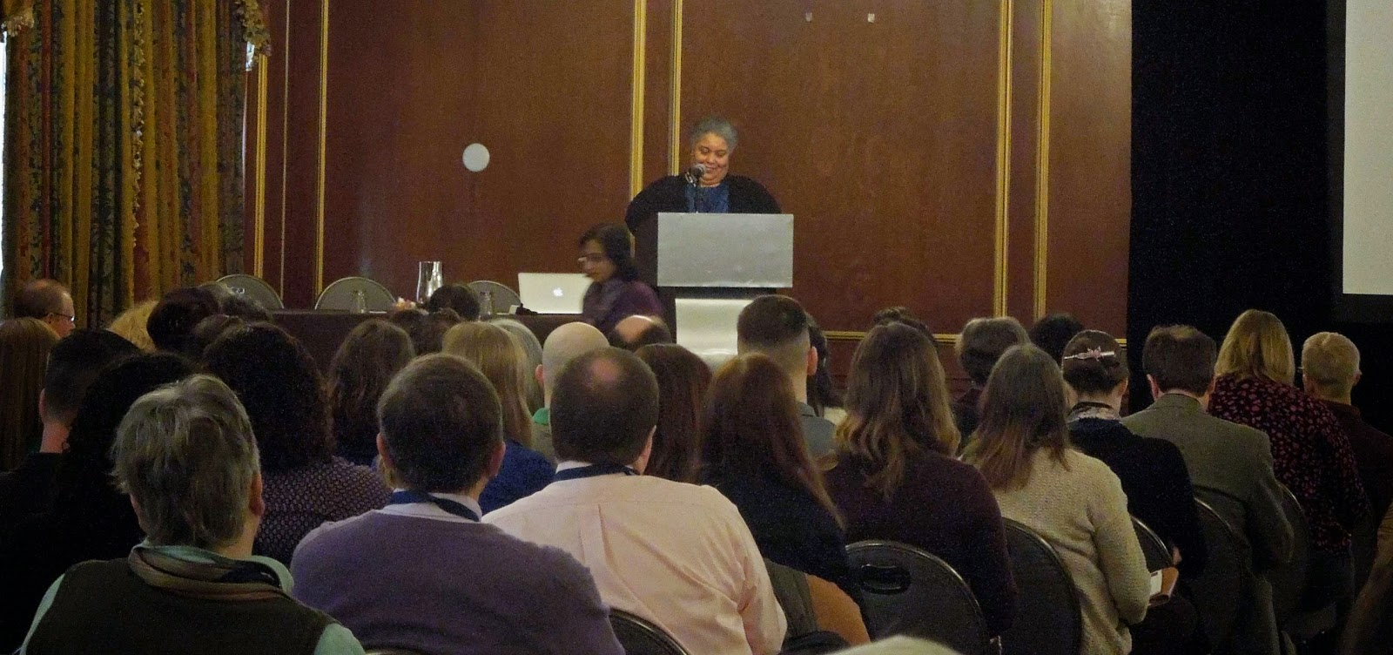
Continuing Education
Professional Organizations
Society of American Archivists
Society of Rocky Mountain Archivists
Colorado Historical Records Advisory Board
Colorado Association of Libraries
Colorado-Wyoming Association of Museums
Northeast Document Conservation Center
More Training
SAA
NEDCC
Lyrasis
Colorado State Library
Graduate Schools

Slide 34
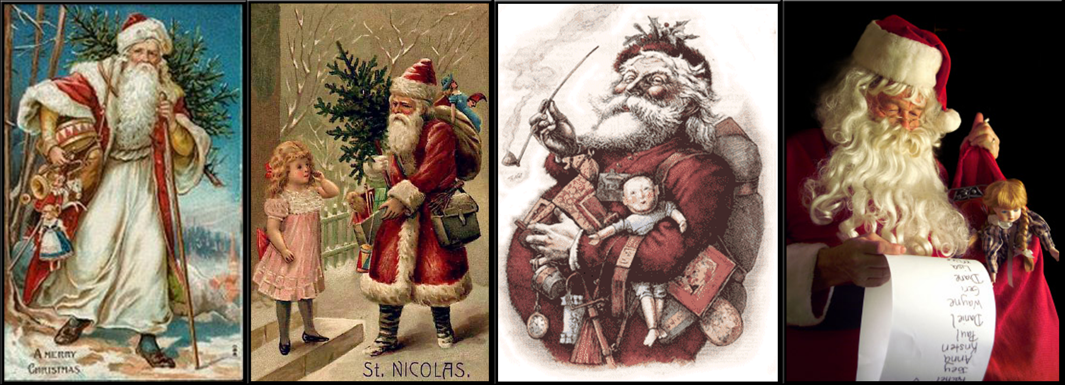
Thank you!

